Slide 1
Aetna Better Health of Kansas
KanCare Enrollment Education Meetings
October 2018

Slide 2
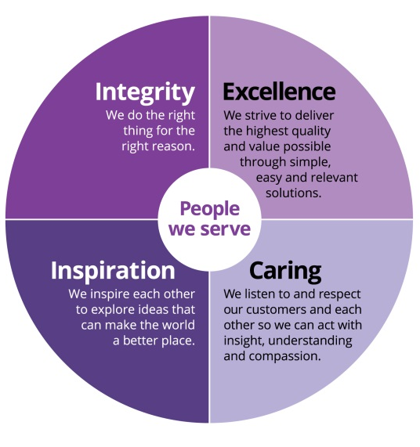
Our members are at the center of everything we do
Aetna at a glance:
50,000 employees
23.5 million medical members
$61 billion revenue
160 years of national and international experience
3rd largest managed care organization in the U.S.
Aetna in Kansas: Kansas Based Network Development Team Approximately 130,000 members with 500+ locally based employees Currently serving approximately 380,000 commercial and Medicare members

Slide 3
Who We Are
Aetna Better Health of Kansas is the operating MCO Name
Separate Operations from our Commercial/Medicare Advantage Plans in Kansas
Designated staff, with Kansas based Executive Leadership for KanCare
Kansas-based Member/Provider Customer Service Call Centers
3 office locations
Overland Park
Topeka
Wichita
Local Network Development Provider Liaisons for Face-to-Face interaction

Slide 4
KanCare Implementation Timeline for Aetna
Amerigroup members will be assigned to Aetna, but can choose any of the three MCOs
All members will receive enrollment packets, beginning in October, and will be allowed a new MCO choice period that runs until April 3, 2019
December 2018 – Member Plan / Primary Care Provider assignments
January 1, 2019 - “Go Live” for Aetna Better Health of Kansas

Slide 5
Becoming a Participating Provider

Slide 6
Building Blocks for Aetna’s Medicaid Network
3 Approaches to Expedite the Network Build
Children’s Mercy Family Health Partner Agreements
Amendment to Your Aetna Commercial/Medicare Agreement
Aetna Better Health of Kansas Direct Agreement

Slide 7
Children’s Mercy Family Health Partner (CMFHP) Agreements
Access to the CMFHP agreements through the provider assignments at the time Coventry purchased CMFHP effective 1/3/12; and then by virtue of the acquisition of Coventry by Aetna on 5/7/13
Fall 2017 –Eligible providers were sent a letter that informed of our intent to access their agreement with steps to “opt-out” if desired.
August/September –
Telephonic outreach by Aetna staff to providers with valid CMFHP agreements to facilitate the credentialing process and obtain current demographic information and rosters. This is to ensure correct information is loaded into our Provider & Claims Platforms and that you are a current Kansas Medicaid provider.
KanCare Regulatory Addendums and Fee Schedules will be sent as well.

Slide 8
Amendment to Your Aetna Commercial Agreement
Providers will be receiving a letter that contains the following:
Applicable amendment
Kansas Medicaid Product Attachment that will outline reimbursement terms and KanCare product participation
Kansas Medicaid Regulatory Compliance Addendum
Applicable credentialing application or demographic review sheet
We recognize that you are credentialed with Aetna, however we need current information to ensure correct information is loaded into our Provider & Claims Platforms and that you are a current KS Medicaid provider.

Slide 9
Aetna Better Health of Kansas Direct Provider Agreements
For Providers who were not part of the CMFHP network or Aetna’s Commercial/Medicare Network:
Utilize telephonic outreach to email agreements directly
Establish a relationship with the negotiator to complete the contracting process

Slide 10
Aetna Better Health of Kansas Provider Credentialing
Follow the State Credentialing Requirements
Using the State’s Credentialing Forms
Will have Provider Supplemental Form to obtain additional information specific to Aetna Better Health data needs for the provider directory.

Slide 11
Items in Flight
The following items are in the process of being completed and submitted to KDHE for approval:
Provider Manual and Other Provider Collateral
Prior Authorization Manual
Appeals and Grievance and Other Key Policies & Procedures
Provider Orientations and Webinars

Slide 12
Key Information
Aetna Better Health will follow and utilize the following:
MCG (Milliman Care Guidelines) for Medical Management
Kansas timely filing requirement of 180 days for original submission; 365 days for corrections.
State’s New Provider Credentialing Process being implemented for 1/1/2019
Subcontractors for Dental, Vision and Non Emergency Medical Transportation (NEMT)

Slide 13
Provider Orientation and Welcome Documents
Starting Fall 2018:
Invitations will be distributed to attend Provider Webinars
Invitations to register and attend Statewide Provider Town Hall Orientations
External Provider Relations Staff will be in place
Provider updates and additional information will be communicated via:
Newsletter (fax & email)
Update information on our website
Provider Relations staff provider visits

Slide 14
Please contact us with any questions
At
​ProviderExperience_KS@aetna.com
1-855-221-5656

