Slide 1
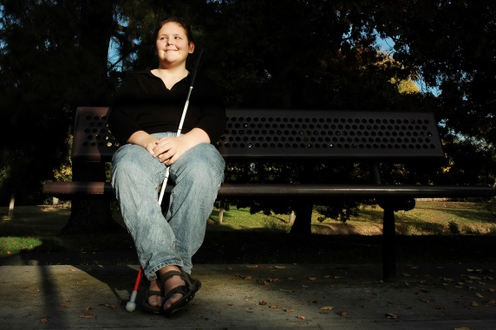
Americans with Disabilities Act Overview
Presentation for the Managed Care Organizations
By Anthony A. Fadale, December 28, 2017
Strong Families Make a Strong Kansas

Slide 2
Objectives of the Training
Obtain an understanding of the amendments to the ADA and the reasons for them
Describe my role and responsibility
Answer questions about the ADA and its amendments
Strong Families Make a Strong Kansas

Slide 3
History of the ADA
The ADA was originally passed by Congress and signed by President Bush in 1990.
The Act is a comprehensive federal statute to protect the civil rights of people with disabilities.
It’s made up of five titles.
It was amended by Congress in order to restore the original intent.
Strong Families Make a Strong Kansas

Slide 4
Titles of the ADA
Title I Employment
Title II Covers State and Local Government
Title III Places of Public Accommodation
Title IV Communications
Title V Miscellaneous
Strong Families Make a Strong Kansas

Slide 5
Reasons the Congress amended the ADA
Courts took a very restrictive view of who is a qualified individual with a disability
Never got to issues of discrimination
Overwhelming bipartisan support to amend statute
Amendments became effective January 2009
Not retroactive
Strong Families Make a Strong Kansas

Slide 6
ADA Amendments Act
Under the ADA, a qualified individual with a disability:
Has a physical or mental impairment which substantially limits one or more major life activities
Has a record of such an impairment
Is regarded as having an impairment
Strong Families Make a Strong Kansas

Slide 7
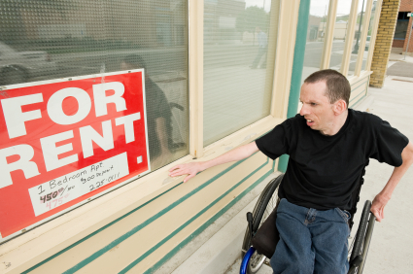
ADA Amendments Act
Provides a broader non-exhaustive list of what would qualify as a substantial impairment. It is broken down into two areas:
Major life activities
Types of major bodily functions
Strong Families Make a Strong Kansas

Slide 8
ADA Amendments Act
Some examples of major life activities include but are not limited to:
Hearing, walking, eating, thinking, concentrating, manual tasks and caring for oneself
Remember, the impairments have to be substantial
Bodily functions are also included:
Bladder, immune system, cell structure (cancer)
Strong Families Make a Strong Kansas
Notes:
(except when evaluating someone under the regarded as analysis)

Slide 9
ADA Amendments Act
Also, these impairments must be individually evaluated and must be done without considering mitigating measures.
Examples include the use of medication, medical supplies and equipment.
This does NOT include ordinary eyeglasses or contact lenses.
Strong Families Make a Strong Kansas

Slide 10
ADA Amendments Act
Being regarded as having an impairment does not require the person to have a substantial impairment.
Can be an actual or perceived impairment
An adverse action must occur.
Not required to reasonably accommodate under the Act
Strong Families Make a Strong Kansas

Slide 11
Being Regarded as, does not include
An impairment that lasts 6 months or less
Broken arm and leg, are examples of what should heal.
Impairment is transitory or minor.
A headache, normal aches and pains
Strong Families Make a Strong Kansas

Slide 12
On the basis of disability
Mirrors Title VII
Could be a neutral policy that as applied could discriminate
Example: No person with a disability will be in the facility.
Makes a blanket exclusion
Not based on essential functions of the job
Strong Families Make a Strong Kansas

Slide 13
Change in emphasis
The amendments only go to the issue of being qualified with a disability.
You must still be qualified to do the essential functions of the job with or without reasonable accommodation.
Places more emphasis on the interactive process and compliance obligations
Strong Families Make a Strong Kansas

Slide 14
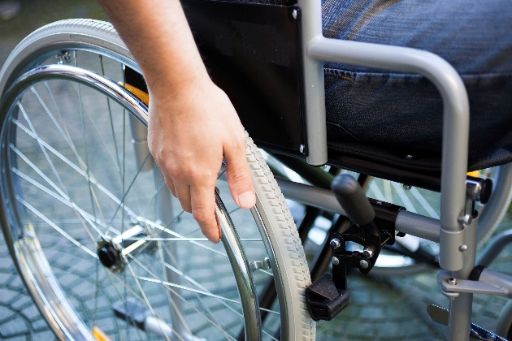
The Amendments do NOT
Change what is a reasonable accommodation.
Change what is a direct threat.
Change the program access requirements.
Change any undue burden or fundamental alteration defenses.
Strong Families Make a Strong Kansas

Slide 15
Title I Employment
Covers employers with 15 or more employees
An individual with a disability cannot be discriminated against in phases of the employment process.
A qualified individual with a disability must be able to perform the essential functions of the job with or without a reasonable accommodation.
Accommodation can not cause undue hardship.
http://eeoc.gov/laws/types/disability.cfm
Strong Families Make a Strong Kansas

Slide 16
Title II Governments
Applies to State and local government
All programs, services and activities must be accessible to and usable by individuals with disabilities when viewed in its entirety.
State law mirrors federal law.
Applies to all programs, services and activities even those that do not receive federal money
Major resource: ADA.gov, http://www.ada.gov
Strong Families Make a Strong Kansas

Slide 17
State ADA Coordinator
Applies to governments that have 50 or more employees
Oversee to ensure compliance with applicable provisions of the ADA and State law
http://admin.ks.gov/offices/personnel-services/policies-and-programs/ada
Those with questions or concerns can contact Anthony Fadale.
Strong Families Make a Strong Kansas

Slide 18
State ADA Coordinator
Works with all State of Kansas agencies and partners to ensure compliance
Works with federal agencies such as DOJ, EEOC HHS and FEMA, to ensure compliance
Federal and State courts have indicated that oversight is my responsibility.
Strong Families Make a Strong Kansas

Slide 19
State ADA Coordinator
Emergency Management Resource to support partners in the Kansas Response Plan
Serve on Kansas Partnership for Accessible Technology
Work to ensure meaningful access to all programs services and activities
Voting
Work with cities, counties and schools, where appropriate
Strong Families Make a Strong Kansas

Slide 20
Examples of issues
Effective Communication: http://www.ada.gov/effective-comm.pdf
Service Animals: http://www.ada.gov/service_animals_2010.pdf
Olmstead: http://www.ada.gov/olmstead/index.htm
Facilities: http://www.ada.gov/2010ADAstandards_index.htm
Strong Families Make a Strong Kansas

Slide 21
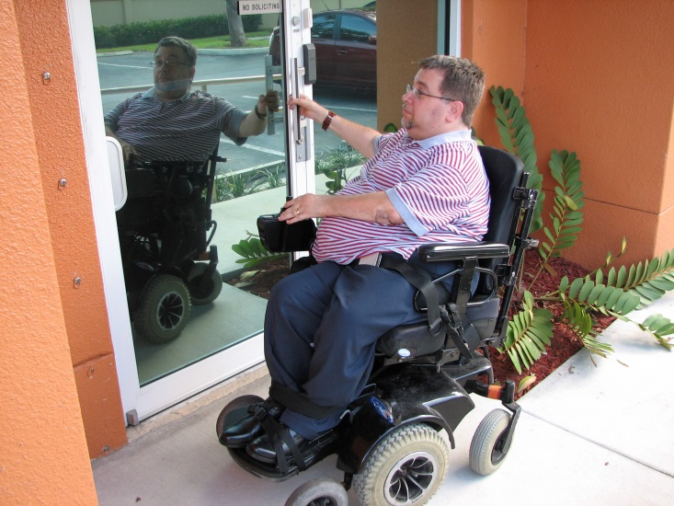
Service Animal Update
Questions and Answers:
http://www.ada.gov/regs2010/service_animal_qa.pdf
Strong Families Make a Strong Kansas

Slide 22
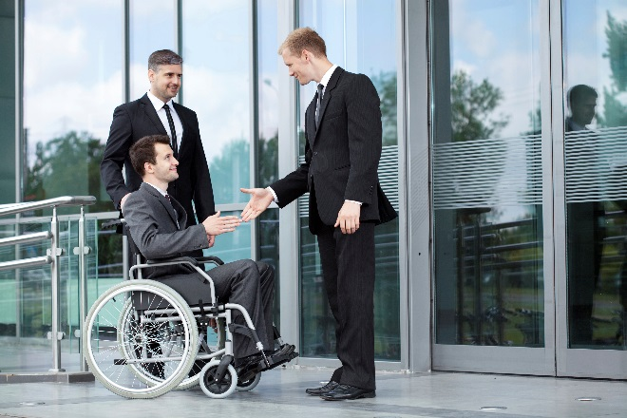
Some Limitations to Providing Accessibility
Governments do not have to provide access that would cause an Undue Financial or Administrative Burden.
Governments do not have to provide access that would cause a fundamental alteration to the program service or activity.
Very high standard
Strong Families Make a Strong Kansas

Slide 23
Title III Public Accommodations
Covers Places of Public Accommodation—types of businesses, (examples are hotels, restaurants, retail stores)
Readily achievable barrier removal http://www.ada.gov/2010ADAstandards_index.htm
Federal and State tax incentives to assist businesses with barrier removal
Strong Families Make a Strong Kansas

Slide 24
More Technical Assistance
Each Region has an ADA Technical Assistance Center.
1-800-949-4232
The Technical Assistance Center can be reached anywhere in the country by calling 1-800-949-4232.
Our Regional Center is in Columbia, Missouri.
The center can offer guidance on the Titles of the ADA.
Strong Families Make a Strong Kansas

Slide 25
Title IV Telecommunications
Governed by the FCC
Accessibility Clearinghouse, http://ach.fcc.gov
Strong Families Make a Strong Kansas

Slide 26
Title V
Title V major provision is the Retaliation provision
Strong Families Make a Strong Kansas

Slide 27
Contact Information
Anthony A. Fadale
State ADA Coordinator
555 S. Kansas Avenue -1st Floor
Topeka, KS 66603
Phone: 785-296-1389
Fax:785-296-4960
Email: anthony.fadale@ks.gov
Strong Families Make a Strong Kansas

Slide 28
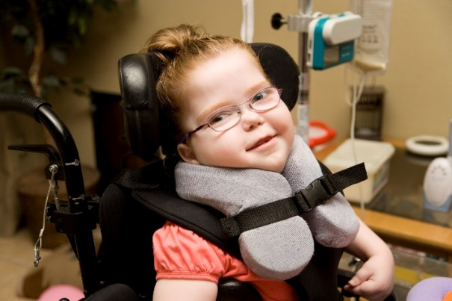
Title II: KanCare and the ADA
Olmstead and HCBS
By Anthony A. Fadale, State ADA Coordinator
December 28, 2017
Strong Families Make a Strong Kansas

Slide 29
K.S.A. 58-1301b
Incorporates Title II of the ADA into State Statute.
201 through 205 Inclusive
Also incorporates its Part 35 regulations
Also Incorporates the Accessibility Guidelines
Strong Families Make a Strong Kansas

Slide 30
K.S.A. 58-1304a(2)
Enforcement Responsibilities
State Programs, and facilities
Secretary of Administration = State ADA Coordinator
Shawnee County Court Case under this provision
Strong Families Make a Strong Kansas

Slide 31
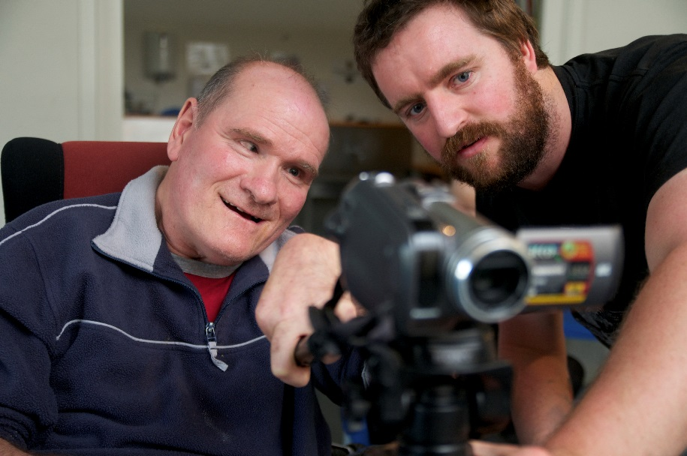
Continued
Case :State ADA Coordinator constitutes Final Agency Action
Strong Families Make a Strong Kansas

Slide 32
Title II of the ADA
Focuses on all the states’ programs, services and activities.
Accessible to and usable by individuals with disabilities when viewed in their entirety
Access must be meaningful - Chaffin
Strong Families Make a Strong Kansas

Slide 33
Olmstead
U.S. Supreme Court decided individuals with disabilities have the right to live in the community with appropriate supports and services
10th Circuit in Fisher v. Oklahoma that an individual with disability need not be in an institution before Olmstead applies
Key: Risk of Institutionalization
Strong Families Make a Strong Kansas

Slide 34
Olmstead
Waiting lists are not prohibited
State must have reasonable movement
State is not intentionally keeping institution open
Federal circuits look at if there is a comprehensive, effectively working program in terms of integrating people into the community
Strong Families Make a Strong Kansas

Slide 35
Undue Burden
Olmstead compliance not required if it creates “undue financial or administrative burden”
Fundamentally alter a program service or activity
Very high standard
Must still make accessible up to the burden
Strong Families Make a Strong Kansas

Slide 36
KanCare and the ADA
KanCare’s Special Terms and Conditions (“STCs”) No. 1 states that KanCare will comply with the ADA
Person-centered service
People must be allowed access to a range of services in the community (IE employment or day activities)
Strong Families Make a Strong Kansas

Slide 37
Medical Services
Services available so that KanCare member is not at unnecessary risk of institutionalization
Example: Fisher case from Oklahoma
Members in community were capped at five
Could have unlimited prescriptions if in a nursing home
Strong Families Make a Strong Kansas

Slide 38
Medical Services cont’d
Fisher continued
Oklahoma’s financial crisis did not cause the provision of drugs in the community to be a “fundamental alteration”
Public policy of keeping disabled in the community outweighed Oklahoma’s need to control expenditures
Only a “short-term” burden
Strong Families Make a Strong Kansas

Slide 39
Employment & Activities
Employment
Integrated employment as first option
Employment First/Summits
MCO pilots
WORK and Working Healthy
Activities
Sporting events, movies
Like nondisabled community members
Strong Families Make a Strong Kansas

Slide 40
DOJ Guidance on Competitive integrated Employment
DOJ issued Guidance on Competitive integrated Employment in October 2016.
Principles Withdrawn
https://www.ada.gov/withdrawn_olmstead.html
ADA legal responsibilities still exist.
Strong Families Make a Strong Kansas

Slide 41
DOJ Guidance Continued
DOJ principles for competitive integrated employment come out of settlement agreements with Oregon and Rhode Island.
Reemphasized at the recent ADA symposium.
Recent brief filed against North Carolina with Court for not honoring their agreement.
Strong Families Make a Strong Kansas

Slide 42
CMS Final Settings rule Rule
Each State must develop a plan to move from Institutional to more integrated settings.
DOJ guidance and final settings rule are similar, but DOJ considers them suppurate.
KDADS is working on getting initial approval.
Strong Families Make a Strong Kansas

Slide 43
CMS Final Rule
KDADS new plan has as part of it the DOJ Integrated Employment principles
State ADA Coordinator part of a multiagency team
Provide training(s) as appropriate
https://www.kdads.ks.gov/commissions/home-community-based-services-(hcbs)/hcbs-waivers
Strong Families Make a Strong Kansas

Slide 44
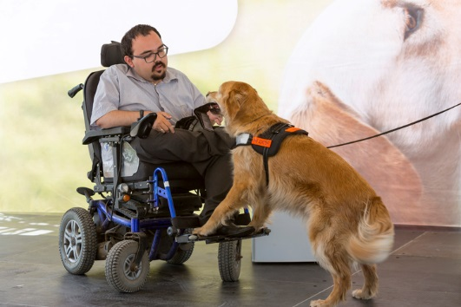
DOJ-HHS guidance involving Families
There are ADA responsibilities with HCBS and ensuring families are not discriminated against.
Guidance issued after Massachusetts Letter of Findings.
Settlement not public
Strong Families Make a Strong Kansas

Slide 45
New DOJ HHS Guidance
Very broad range of issues covered by the guidance.
Covers both children and parents issues.
https://www.ada.gov/doj_hhs_ta/child_welfare_ta.pdf
Strong Families Make a Strong Kansas

Slide 46
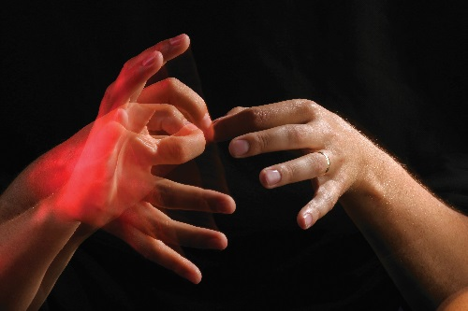
New DOJ HHS Guidance
Follow the same principles as Olmstead and Fisher.
Keep them from a Unnessasary Risk of Institutionalization.
Keep in the community with appropriate supports and services.
Strong Families Make a Strong Kansas

Slide 47
New DOJ HHS Guidance
Core principles:
Individualized assessment
Equal opportunity to the programs, services and activities
Expect intensive coordination with these cases so that we can deliver appropriate level of service so individual can stay in the community
Strong Families Make a Strong Kansas

Slide 48
Accessible websites
STC 43 requires KanCare website to be accessible to disabled
ITEC Policy 1210
State, in turn, expects MCO websites to be accessible as well
MCO can use State’s Accessibility Management Platform (AMP) to ensure KanCare program pages are accessible
MCO sites will be evaluated using AMP
Strong Families Make a Strong Kansas

Slide 49
Other Issues you need to be aware
Housing
Emergency Management
Transportation
Guidance is being updated on these issues. I work with the various agencies on implementing it.
Strong Families Make a Strong Kansas

Slide 50
Housing
Make sure clients are in accessible housing
I work with Housing Resource Corporation to assist in development of accessible housing
This commitment is shared with HCBS partners.
Strong Families Make a Strong Kansas

Slide 51
Transportation
In addition to what the MCOs are required to provide:
KDOT works with partners with coordinated transit district providers to provide accessible and usable transit.
Example: Access transit will be provided to Mars facility.
Strong Families Make a Strong Kansas

Slide 52
Emergency Management
I work with KDEM and other Emergency Support functions (ESF) to provide support for the counties.
Latest Kansas Response Plan is on KDEM website.
I believe you will be an integral partner in our efforts to reintegrate Kansans with disabilities back into the community.
Strong Families Make a Strong Kansas

Slide 53
Olmstead Assistance
Let KDHE and/or KDADS know of potential Olmstead issues so they can be properly evaluated/corrected.
More in-depth training available upon request.
Strong Families Make a Strong Kansas

