Slide 1
Medicare Basics
&
How they are related to the KanCare/Medicaid Application

Slide 2
What is Medicare?
Medicare is government sponsored health care for seniors and those with disabilities.
Medicare is often confused with Medicaid, which was created to provide medical care for those in poverty.
Medicare was designed to provide medical coverage to individuals on Social Security.

Slide 3
Who is Eligible for Medicare?
Medicare works a lot like regular health insurance, except the government is the one reimbursing doctors and hospitals, rather than a private insurance company.
An individual becomes eligible for Medicare:
When they turn age 65,
Before age 65 if determined disabled (by SSA)
If diagnosed with permanent kidney failure requiring dialysis or a transplant.

Slide 4
Basic Terms to Understand
Part A
Part B
Part C
Part D

Slide 5
Basic Terms to Understand
Medigap Insurance Plans
Supplemental Insurance Plans
Medicare Advance Plans
SHICK Counselors
Medicare Savings Program
What to know about Medicare, when completing the Medicaid (KanCare)Application

Slide 6
Medicare Part A
Sometimes called Hospital Insurance and covers hospitalization due to catastrophic events.
Overnight Hospital stays
Emergency care
Including: hospital room, tests, doctor fees and even food
If certain conditions are met, it can also help with:
skilled nursing facilities
home health agencies
hospice
Notes:
You get Part A just by signing up for Medicare. For most, you get Part A for free and automatically. To have no premium, you must have paid into Social Security through employment for at least 10 years.
Parts B, C and D are all optional and come with monthly premiums.

Slide 7
Medicare Part B
Sometimes called Medical Insurance helps pay for medically necessary services, such as:
Doctor visits
Outpatient care
Routine health procedures (physicals, blood pressure checks, x-rays, lab tests, etc.)
It also covers some preventative services to help maintain your health and to keep certain illnesses from getting worse:
Mammograms
Prostate exams
Diabetes screenings
Notes:
Most people have to sign up for Part B, and it does come with a premium. To make it easier, you can have your Part B premium deducted from your Social Security check each month.

Slide 8
Medicare Part D
Medicare Part D provides prescription drug coverage.
This coverage may pay for or lower prescription drug costs.

Slide 9
Medigap Insurance Plans
Medigap Plans are also referred to as Medicare Supplemental Plans.
Managed by private insurance companies.
Medicare does not pay for all costs that come with your Part A and B benefits. Recipients may have to pay a deductible, co-pay or coinsurance for the costs not covered.
Supplemental Plans or Medigap plans are designed to cover some of those costs not covered by Original Medicare, Parts A or B.

Slide 10
Medigap Insurance Plans
These Supplemental plans do NOT cover:
Dental
Vision
Hearing
Long Term Care
Prescription Drugs
Individuals who choose a Medigap or Supplemental plan may add a Part D prescription drug plan for more complete coverage.
Notes:
Medigap plans allow you to choose your own provider
Travel with you if you move or travel within the U.S.
Individuals with Medigap plans will pay both their Medicare Part B premium and their Medigap Premium. And if they add Part D, they will be responsible for Part D premiums as well.

Slide 11
Medicare Part C
Medicare Part C is also referred to as Medicare Advantage Plans.
Medicare Advantage Plans (Part C Plans) are managed by private insurance companies that are approved by Medicare.
Notes:
To receive Part C, you must be eligible for Medicare and you must be paying your Part B premium. Some individuals who are still using their Employment Insurance Plans (late retirement) may not need Part B coverage yet, and so have not signed up for it. If this is true for you, you will not yet be eligible to sign up for Part C.
If you do not sign up for Part C when you turn 65 years old, you can still sign up once a year during the annual enrollment period.
Many Medicare Advantage Plans (Part C Plans) come with an annual deductible to help keep your monthly premium down. Then you pay a co=pay and coinsurance for only those services you use and not for those you do not.
You can also save money by choosing a provider within the network. Some Advantage Plans allow you to choose out of network providers, but they often cost more.

Slide 12
Medicare Part C Plans (Advantage Plans)
Combine the Medicare benefits of Parts A & B (Orignal Medicare).
May offer additional coverage not included in Parts A & B, like dental or vision, or gym memberships.
Some Medicare Advance Plans (Part C Plans) also include Part D prescription coverage; if not, you have the option of adding Part D separately.
C = A + B + Additional Coverage + D
Notes:
To receive Part C, you must be eligible for Medicare and you must be paying your Part B premium. Some individuals who are still using their Employment Insurance Plans (late retirement) may not need Part B coverage yet, and so have not signed up for it. If this is true for you, you will not yet be eligible to sign up for Part C.
If you do not sign up for Part C when you turn 65 years old, you can still sign up once a year during the annual enrollment period.
Many Medicare Advantage Plans (Part C Plans) come with an annual deductible to help keep your monthly premium down. Then you pay a co=pay and coinsurance for only those services you use and not for those you do not.
You can also save money by choosing a provider within the network. Some Advantage Plans allow you to choose out of network providers, but they often cost more.

Slide 13
Two Roads to Medicare
Original Medicare
(Parts A & B)
Medicare Advantage Plans
(Part C)

Slide 14
Road One
Original Medicare: Parts A & B
You can add a Medigap (Supplemental) Plan to help cover things that A & B do not cover
You can also add Part D, prescription coverage
A + B + Supplemental Ins. (Medigap) + D

Slide 15
Road Two
Medicare Advantage Plan (Part C)
Combines both Parts A and B
Often covers services not covered by A and B, like vision and dental
May also include Part D, prescription coverage.
C = A + B + Additional Coverage + D

Slide 16
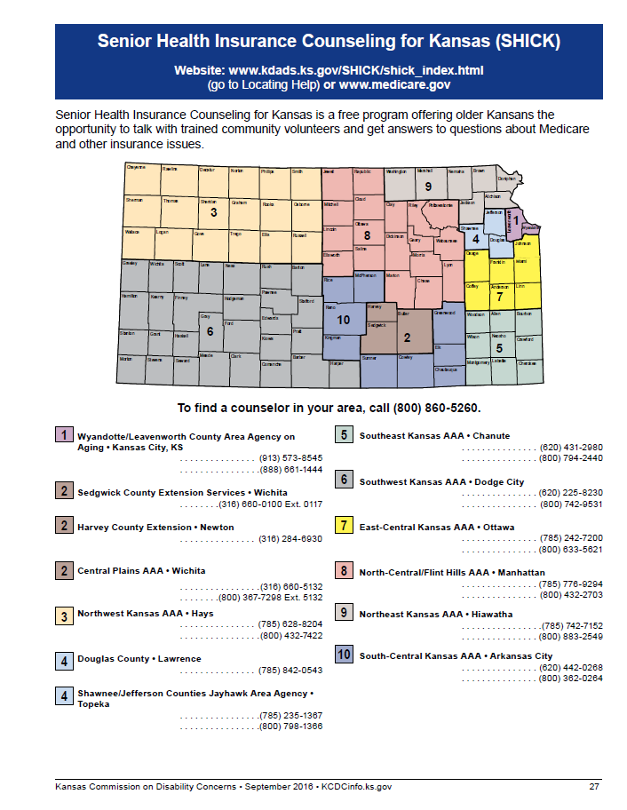
SHICK Counselors
You have the chance to change Medicare plans once a year during the Annual Enrollment Period (Oct 15th -Dec 7th )
To find out how to enroll, change your current Medicare coverage or ask other Medicare questions contact a local SHICK Counselor: 1-800-860-5260
Kansas Commission on Disability Concerns, Service Maps: https://kcdcinfo.ks.gov/docs/default-source/dc---resources/disability-service-mapsbf4aae1493d465f8aa5cff000080ad8b.pdf?sfvrsn=0

Slide 17
SHICK Counselors
Senior Health Insurance Counseling for Kansas (SHICK) is a free program offering Kansans an opportunity to talk with trained, community volunteers and get answers to questions about Medicare and other insurance issues.
SHICK provides you with many resources that will help you with your questions about Medicare.
SHICK counselors are located throughout the state, and help individuals to stay informed on changing conditions in health care insurance and to cut through the confusion.
SHICK counselors receive training on Medicare, Medicare Supplement Insurance, Long-Term Care and other health insurance subjects that concern older Kansans.
SHICK counselors do not work for any insurance company. The goal is to educate and assist the public to make informed decisions on what's best for them.

Slide 18
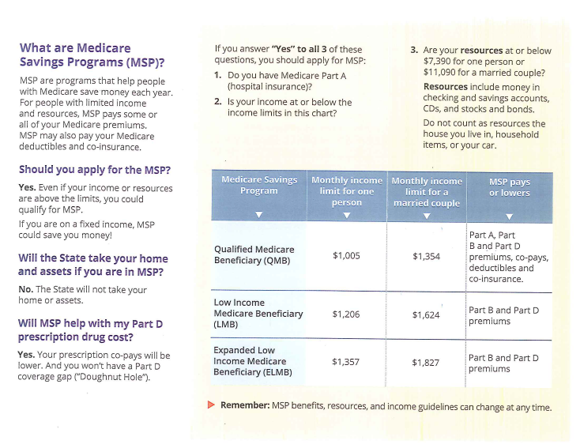
Medicare Savings Program (MSP)
This program is for people who have Medicare and helps with some of the out-of-pockets expenses. This program may pay for Medicare Part A, Part B and/or Part D premiums, deductibles, and copayments (based on income).
Notes:
Be sure to select one of these two boxes if the applicant has Medicare.

Slide 19
Medicare Savings Program
Notes:
The Medicare Savings Program is one of the programs you can apply for on the Medical Assistance Application for the Elderly and Disabled.

Slide 20
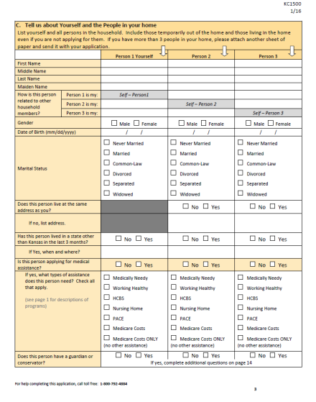
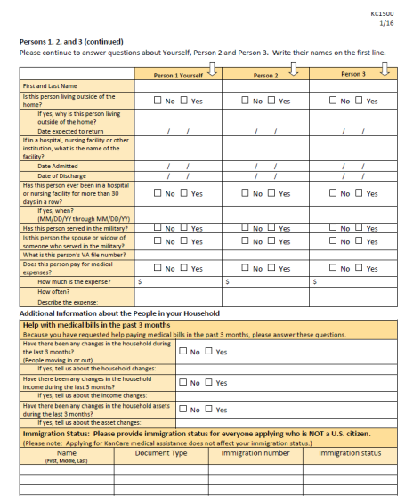
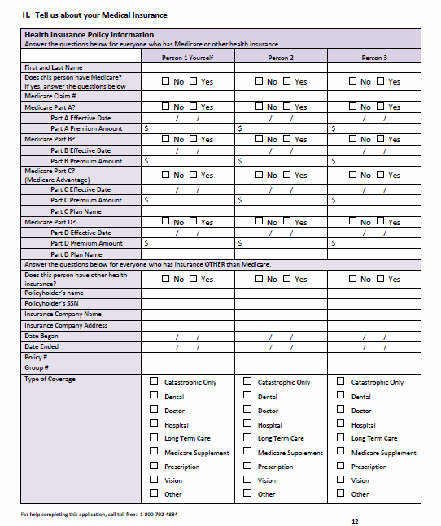
What to know about Medicare, When Completing a Medicaid Application
There are currently three pages of the KanCare Application for the Elderly and Persons with Disabilities that ask questions regarding Medicare.
Page 3
Page 5
Page 12

Slide 21
Page 3

Slide 22
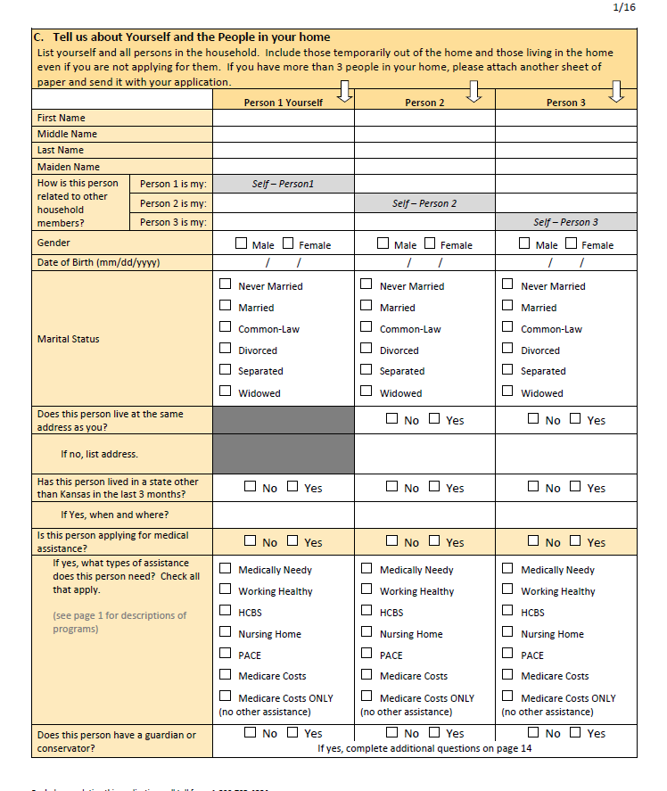
What types of assistance does this person need? Check all that apply.
P3, L16
Any Medicare recipient can check Medicare Costs in addition to other Medicaid programs they would like to apply for.

Slide 23
Medicare Costs vs. Medicare Costs ONLY
Checking the “Medicare Costs” box alerts eligibility specialists to check for their ability to enroll in a Medicare Savings Plan.
Checking the “Medicare Costs ONLY” box asks that Medicaid coverage not be considered, only the Medicare savings program.
P3, L16

Slide 24
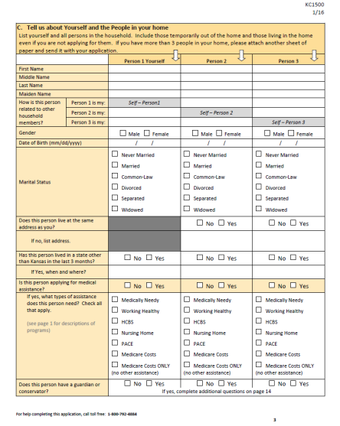
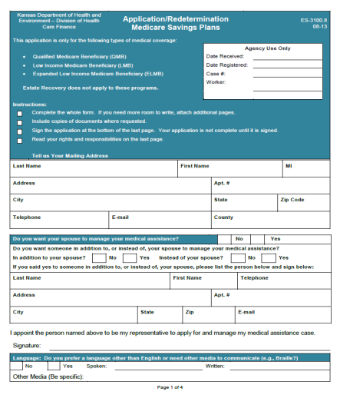
Which Application do I Use?
If you have someone who may be eligible for both Medicare and Medicaid, they can complete a KanCare application (16 pages in length).
If you have someone who knows they are not eligible for Medicaid, but they need help ONLY with their Medicare premiums and co-payments, they can complete a Medicare Savings Program application. (3 pages in length)

Slide 25
Page 5

Slide 26
Does this person pay for medical expenses?
You can enter the applicant’s private or Medicare supplemental insurance premiums here.
If the applicant has ongoing medical expenses that they pay out of pocket for, you can list this here.
P5, L14-17
Notes:
See “Allowable Expenses” on next slide.

Slide 27
Allowable Expenses
Consumers may be able to reduce the amount they owe on their Client Obligation, Patient Liability or Spenddown by submitting receipts for medical costs NOT covered by Medicaid or other insurance.
Allowable Expenses:
Health Insurance Premiums
Medicare Premiums
Expenses that Medicaid, Medicare and other health insurance does not cover (for self or for spouse’s/dependent family members’ non-covered medical expenses)

Slide 28
Page 12
1. Medicare
(Parts A, B,C, D)
2. Other Health Insurance
(Supplemental Plans)

Slide 29
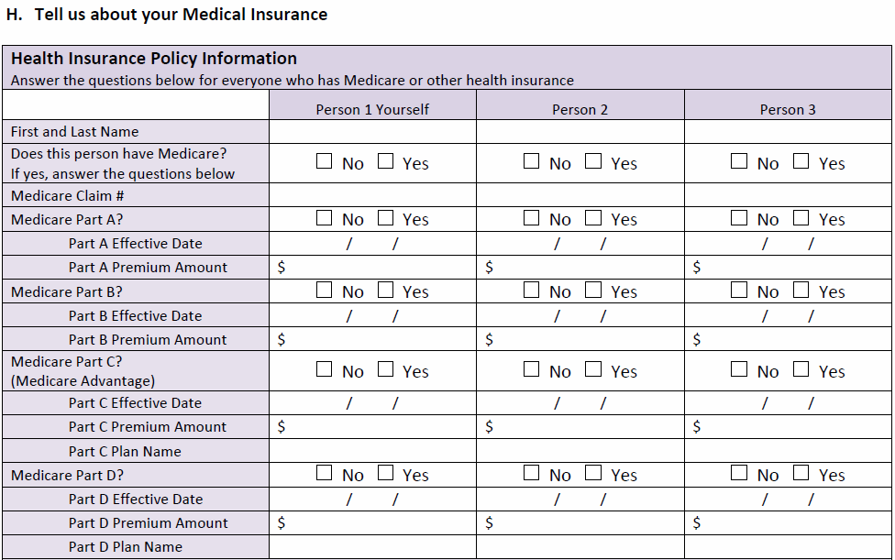
Do you have Medicare?
P12,
Section H, Lines 1-19
Answer the questions the best you and the consumer can.
You can find many answers on the Medicare card or the consumer can call the phone number on the card for answers to these questions.

Slide 30
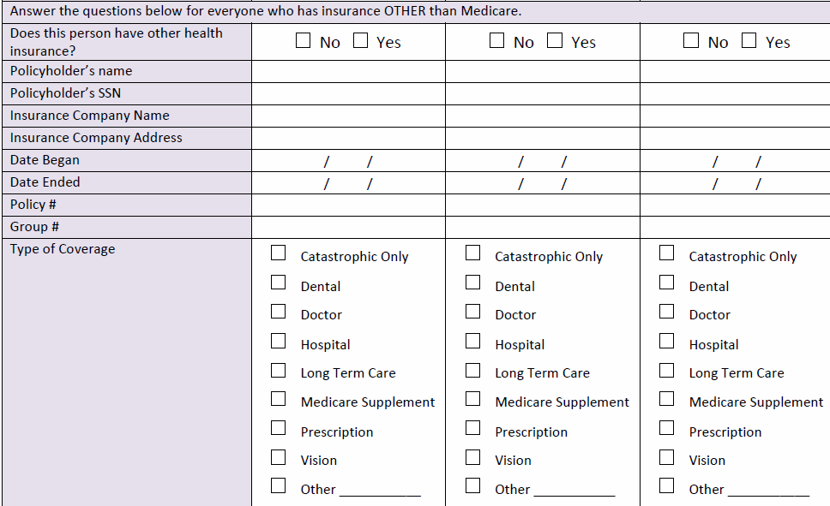
Health Insurance (Other than Medicare)
P12,Section H, Lines 20-30

Slide 31
Health Insurance (Other than Medicare)
With “private insurance,” such as Blue Cross Blue Shield or a Medicare Supplemental Health Insurance Policy (Medigap Policy) use the bottom section of this application page to document any private health insurance policies the applicant may have.
Private Health Insurance may include:
Medicare Supplemental Health Insurance Policies
Health Insurance through an employer
Long Term Care Insurance
The eligibility team needs the applicant to submit:
A copy of the front and back of the insurance card
Proof of the monthly premium the applicant pays*
*Providing the eligibility team with the monthly premium amounts will lower a person’s monthly “patient liability/client obligation” (the monthly premium the KanCare consumer must pay for his/her share in the cost of medical services).

Slide 32
Families with Children Application
Notes:
The Medicare Savings Program is one of the programs you can apply for on the Medical Assistance Application for the Elderly and Disabled.

Slide 33
Families with Children Application, Page 11

Slide 34
General Medicare Questions
Medicare?
SHICK Counselor: 1-800-860-5260
Kansas Commission on Disability Concerns, Service Maps: https://kcdcinfo.ks.gov/docs/default-source/dc---resources/disability-service-mapsbf4aae1493d465f8aa5cff000080ad8b.pdf?sfvrsn=0

