Slide 1

Hearings

Slide 2




Is a HEARING right for your current situation?
If you are a current KanCare member who has already submitted an appeal, and that appeal has been denied, you may now submit a request for a state fair hearing (second chance to have someone hear your case).
If you are not currently receiving KanCare services, but have (1) applied for KanCare and were denied or (2) were previously receiving KanCare services, but were notified that you are no longer eligible, you may submit a request for a state fair hearing (without first submitting an appeal).
If you have been waiting over 45 days (or over 90 days if claimed disability status) for your application to process, you can request a state fair hearing.
Appeal
KanCare Coverage

Slide 3

Hearings - Terms to Know
Administrative Hearing
State Fair Hearing
Office of Administrative Hearings
OAH

Slide 4
State Fair Hearing – an administrative hearing involving the presentation of evidence and argument before a presiding officer from the Kansas Office of Administrative Hearings.
In regards to KanCare services/benefits and eligibility, these three terms are interchangeable:
Hearing
State Fair Hearing (SFH)
Administrative Hearing

Slide 5
What is a State Fair Hearing?
A SFH is an opportunity for the KanCare member to (1) speak about his/her issue and (2) present documentation that supports their case.
The KanCare member, an MCO representative, and a state representative meet before an impartial Presiding Officer/Administrative Law Judge.
The Presiding Officer/Administrative Law Judge will write an Initial Order based upon what is presented by the member, the MCO and state agency representative at the hearing.

Slide 6
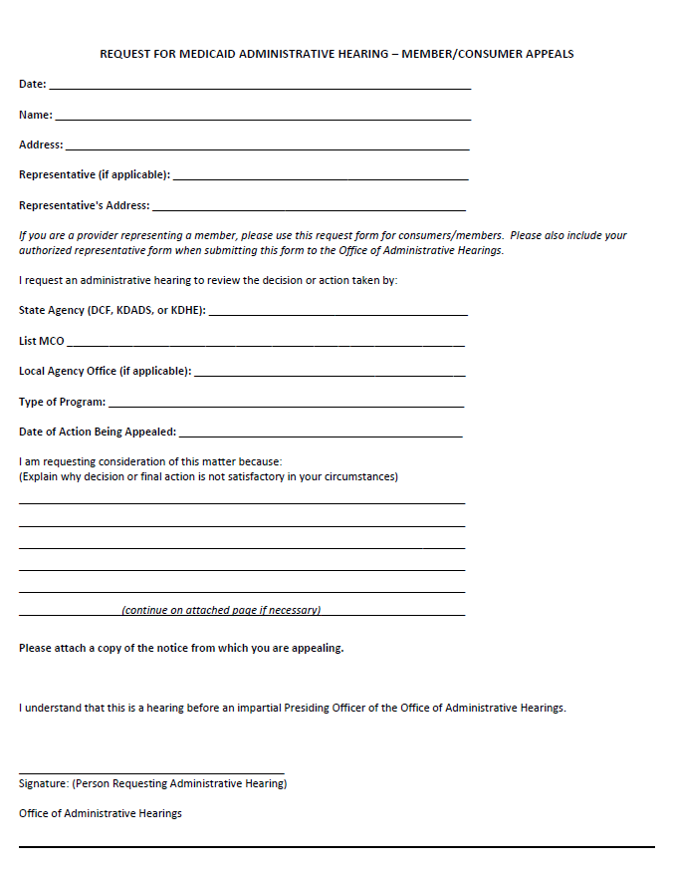
What is the Office of Administrative Hearings?
The Office of Administrative Hearings (OAH) is where you will submit a request for hearing.
OAH

Slide 7

Where is a SFH held?
It is usually done on the phone as a conference call.
However, a member can request to have the hearing in person if preferred. (There is no expense for this.)

Slide 8
Possible Reasons to Request a SFH
You are a current KanCare member who has appealed an MCO’s adverse action, and that appeal has been denied.
You have been denied KanCare services and you believe this was due to a mistake made by the KanCare Clearinghouse or state agency in the processing of your renewal form or application.
You have lost services because you were found to be no longer eligible, but you believe this a mistake on the part of the KanCare Clearinghouse.
You have been waiting over 45 days for your KanCare application to process (or over 90 days if you have claimed a disability status).

Slide 9

Waiting Over 45 Days – Application Processing
If you request a hearing because you applied for KanCare and have been waiting over 45 days (or over 90 days if claimed disability status) you can request a state fair hearing.
Suggestion: Before you request a hearing, make sure you have done your due diligence and have contacted the KanCare Clearinghouse to confirm they have received all of the documentation they need from you to determine your eligibility.

Slide 10
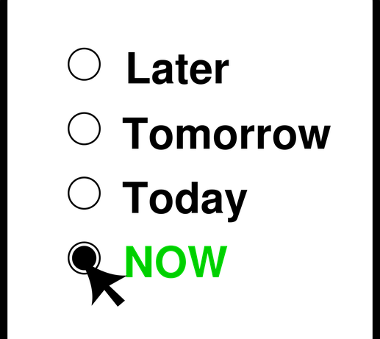
Important Deadlines
Deadline to request a state fair hearing
Deadline to ask for your services to continue during the hearing process

Slide 11


Deadline to Request a Hearing – After an Appeal
If you request a hearing because you are a current KanCare member that has already appealed an MCO’s adverse action, and that appeal was denied...
The request for hearing must be submitted within 30 calendar days (plus 3 calendar days if the notice was mailed) from the date on the “appeal denial notice.”
You have 30 calendar days from the date on the “appeal denial notice” to request a SFH.

Slide 12
Deadline to Request a Hearing – Eligibility
If you request a hearing because you (1) applied for KanCare and were denied or (2) were previously receiving KanCare services, but were notified that you are no longer eligible for KanCare coverage…
The request for hearing must be submitted within 30 calendar days (plus 3 calendar days if the notice was mailed) from the date on the “notice of eligibility denial.”
You have 30 calendar days from the date on the “notice of eligibility denial” to request a SFH.

Slide 13


No Exceptions for Missed Deadlines!
  Do Not Wait: Submit your hearing request immediately to the OAH in writing, using the correct form. The initial request for hearing does not have to state all the details of your case.
  Provide an explanation of why the decision/final action is unsatisfactory in your circumstances.
  Include a copy of the “Notice” letter (denial of appeal, denial of eligibility, denial of renewal)
Follow up with documentation that will support your case.

Slide 14
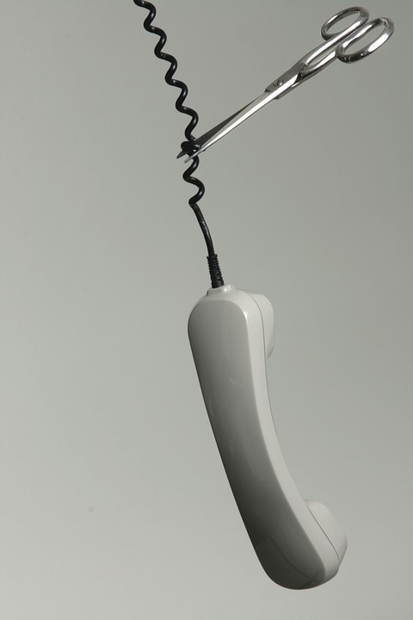
Continuation of Services - Deadlines
For Non-HCBS Related Services:
If you wish to keep any services that are “non-HCBS Waiver related” through the outcome of the SFH decision, the member (or their authorized representative) must request the following within 10 calendar days of the mailing date on the “notice” letter (appeal denial, renewal denial).
  Request State Fair Hearing (submit to OAH) and
  Request continuation of non-HCBS related services (submit to MCO)
Please keep in mind that you may have to pay for those covered, disputed services if you lose the hearing.

Slide 15

Continuation of Services – Deadlines
For HCBS Related Services:
If you wish to keep any services that are “HCBS Waiver related” through the outcome of the SFH decision, the member (or their authorized representative) must request the following within 10 calendar days of the mailing date on the “notice” letter (appeal denial, renewal denial).
  Request State Fair Hearing (submit to OAH) and
  Request continuation of HCBS related services (submit to MCO)
You will not have to pay for these covered, disputed services even if the hearing decision is not in your favor.

Slide 16
What form do I use?
Request form for member/consumer Administrative Hearings: https://www.oah.ks.gov/Files/MedicaidConsumerRequestForAdminHearing.pdf
Notice of Withdrawal (in case you decide not to go forward with the hearing): https://www.oah.ks.gov/Files/withdraw.html

Slide 17
Are you assisting someone with State Fair Hearing?
(Eligibility Cases Only: Applications & Renewal)
If you are assisting someone with an a State Fair Hearing (regarding eligibility) you should use the “Medical Representative Authorization Form.”
The term “medical representative” is limited to eligibility decisions.
Please do not use the term “medical representative” for MCO members appealing MCO decisions.

Slide 18
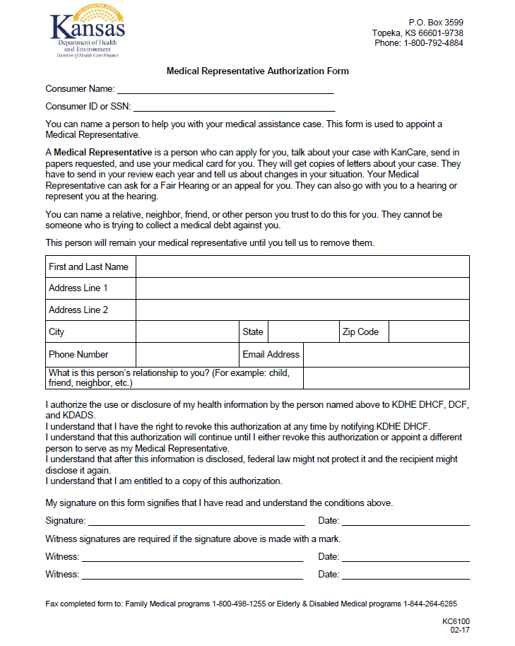
Medical Representative Authorization Form
If you assisting and applicant/member with an “Eligibility Case” please complete and submit this form with the request for state fair hearing.
This form is only for use when (1) helping an applicant apply for or (2) renew Medicaid.
http://www.kdheks.gov/hcf/data_requests/download/KC6100MedicalRepresentativeAuthorizationForm_EN.pdf

Slide 19
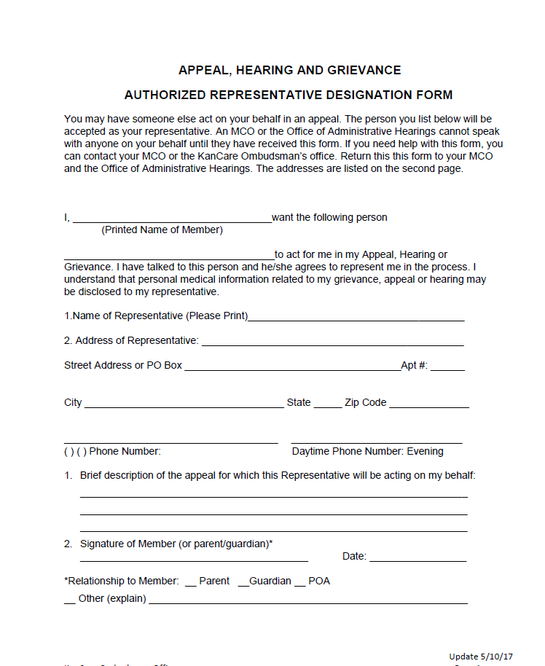
Are you assisting someone with a State Fair Hearing? (Regarding a MCO Appeal Denial)
If you are assisting someone with an MCO appeal (or a State Fair Hearing because that appeal was denied)
You should use the Authorized Representative Designation Form in each of the MCO’s Member Handbooks .
You can also find a generic form on the KanCare Ombudsman’s website for use on the KanCare Website.
http://www.kancare.ks.gov/kancare-ombudsman-office/appeals-information.
Notes:
Amerigroup Handbook: https://www.myamerigroup.com/Documents/KSKS_Member_Handbook_ENG.pdf
Appeals and State Fair Hearings: p. 70-75
Sunflower Handbook: https://www.sunflowerhealthplan.com/content/dam/centene/sunflower/pdfs/Sunflower-member-handbook-English.pdf
Appeals and State Fair Hearings: p. 40-42
United Handbook: http://www.uhccommunityplan.com/content/dam/communityplan/plandocuments/handbook/en/KS-MemberHandbook.pdf
Appeals and State Fair Hearings: p. 61-62

Slide 20

What supporting documentation do I need?
The Presiding Officer will enter an initial order based upon what is presented by both the member and the state agency or MCO representative at the hearing. So it is important to come to the hearing prepared with documentation that will support your case.
What type of documentation you need, depends on why you are requesting the state fair hearing.
  Are you requesting the hearing because the MCO has denied your appeal?
  Are you requesting a hearing because you have lost or been denied coverage due to ineligibility or non-renewal?
  Are you requesting a hearing because you have been waiting for your KanCare application to process for over 45 days (over 90 days if the applicant claimed disability status)?

Slide 21

  Are you requesting the hearing because the MCO has denied your appeal?
Appeal
If so, the supporting documentation for the SFH should Identify:
The adverse action that has been determined by the MCO regarding services/benefits
Why this action should not take place and problems it will cause
The effect this action will have both short and long-term on the physical, mental and emotional health of the member
  This documentation can be in the form of a letter from yourself and other professionals.

Slide 22
  Are you requesting the hearing because your KanCare coverage has been terminated or denied due to ineligibility?
Eligibility
If so, the supporting documentation you provide needs to show:
The KanCare Clearinghouse or state agency did not follow the rules in processing the application or renewal, rather than show reasons why a person needs KanCare.
Examples:
Renewal was turned in on time with all information filled out and KanCare coverage was still dropped with no other reasons given.
My application was denied because I was lacking necessary information, but I have the fax receipt showing that this information was both sent and received on a specific date and was on time.

Slide 23

  Are you requesting the hearing because your KanCare application has been processing for over 45 days
  (Over 90 days if applicant claimed disability status)?
If so, the supporting documentation you provide needs to show that you have done your due diligence:
You have sent in all documentation requested by the KanCare Clearinghouse (the required documents needed to determine your eligibility) in a timely manner.
You have contacted the KanCare Clearinghouse in a timely manner to ensure they have received all the documents you have submitted.

Slide 24
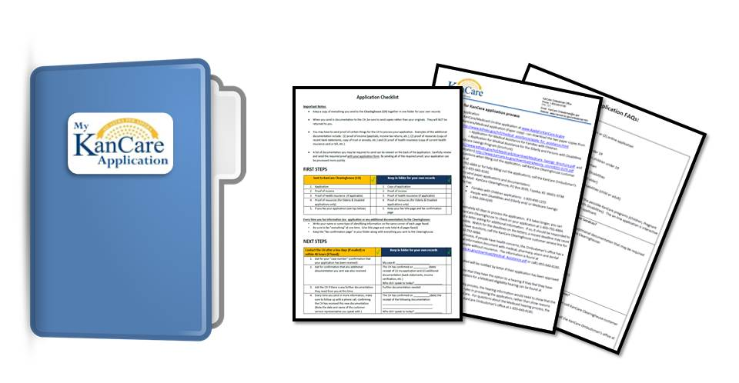
Application Assistance Folder
You may want to use the forms available in the KanCare Ombudsman’s Application Assistance Folder to help:
Provides guidance on (1) what documentation to submit with the application and (2) what questions to follow up with after they have submitted their application.
Helps to keep the KanCare applicant’s application and additional documentation organized.
Answers some of the most frequently asked questions about the application process.
The Application Assistance Folder can be found at: http://www.kancare.ks.gov/kancare-ombudsman-office/resources

Slide 25

Legal Representation for SFH
You may have an attorney represent you at the hearing.
The KanCare Ombudsman’s office recommends members consider having a lawyer assist them in preparing for the state fair hearing and come to the hearing with them. (The attorney will be at your expense.)
Why a consumer may wish to have an attorney present?
The State will be representing the MCO at the Hearing.
A lawyer will help you organize your paperwork.
It is easy to get flustered. Having legal representation may help with this as well.

Slide 26

Who represents the MCO at the Hearing?
A State Fair Hearing does not involve the member versus the MCO’s lawyer.
The MCO is represented by the State at the hearing (member versus a State employee who represents the MCO).
If the State does not agree with an MCO decision, it will be addressed and resolved prior to a hearing.
If a hearing does occur, it is because the State agrees with the MCO’s decision and is defending the MCO’s decision – or – defending the State’s eligibility decision.

Slide 27

Selecting an Attorney
If you hire an attorney, he or she must be licensed in the State of Kansas and enter their appearance on your behalf prior to the hearing.
The attorney will be at your expense.
If you choose Kansas Legal Services (KLS) or Disability Rights Center of Kansas (DRC), they do not charge a fee.
The KanCare Ombudsman’s State Fair Hearings information packet includes Legal Services information.

Slide 28
State Fair Hearing Recap
A letter is mailed to notify a consumer that (1) their appeal has been denied by the MCO or that (2) they have been denied KanCare services due to ineligibility.
  This letter will be dated.
  The letter will also tell the member that there is an option to appeal the action. (In this case, the appeal will be a SFH).
  The request for hearing must be submitted to the OAH within 30 calendar days (plus 3 calendar days if the notice was mailed) from the date on the notice.
    If they wish to have the disputed services continue during the SFH process, however, they must both (1) request the hearing (to OAH) and (2) request for continuation of services (to MCO) within 10 calendar days from the mailing of the notice.
Notes:
This is true for both HCBS and non-HCBS related services.

Slide 29

State Fair Hearing Recap
2. Members/Applicants should submit their hearing request to the Office of Administrative Hearings (OAH) as soon as possible.
  A SFH request must be made in writing and submitted by mail or fax, using the correct form: “Request for Medicaid Administrative Hearing-Member/Consumer Appeals.”
  Include a copy of the “Notice of Denial” letter (examples: denial of appeal, denial of eligibility) with your hearing request.
  Follow up with documentation that will support your case.
  Both the KanCare member and a State representative (who is defending the MCO’s decision) will meet before a Presiding Officer to make their case.

Slide 30

Hearing Resolution Timeline
The Office of Administrative Hearings is required to issue a hearing decision within 30 calendar days of the hearing date.

Slide 31
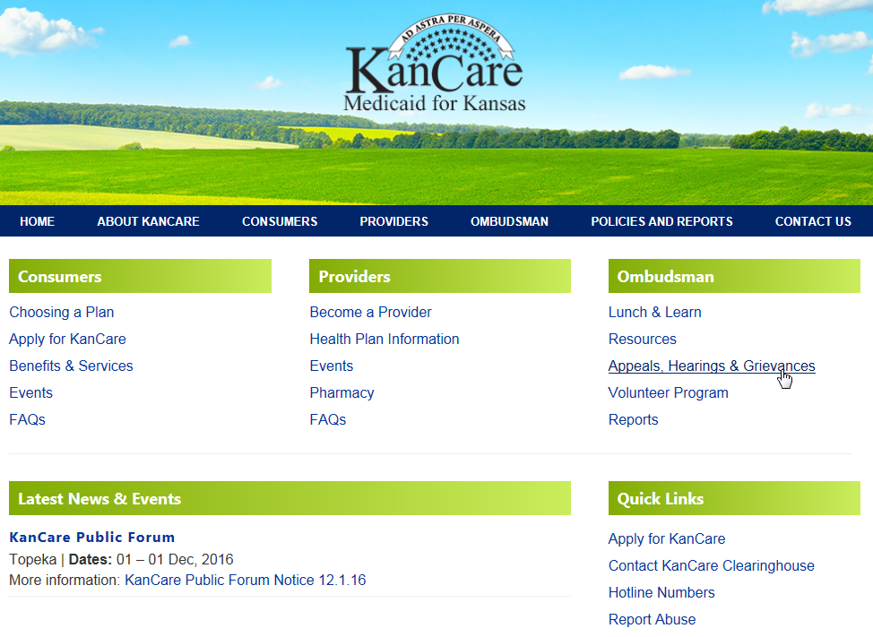
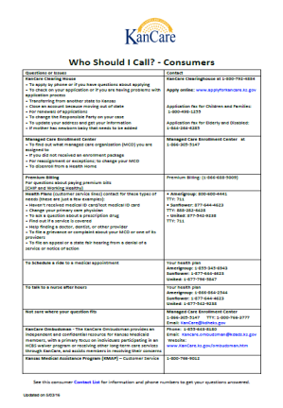

State Fair Hearing Resources
KanCare website > Ombudsman Section> Appeals, Hearings & Grievances
KanCare Resource Binder: > Appeals, Hearings & Grievances
“Who Should I Call?” Consumers list > Health Plan Issues
Notes:
There is an information packet available that defines the state fair hearing process, what documentation is needed and provides the necessary contact information.
It also provides an “Request for Administrative Hearing” form that helps the KanCare member/applicant to organize the important information they need to request a hearing. This form is used to submit the request for hearing to the OAH.
If you know someone who needs this guide, you can find this guide on the KanCare website.
To find the guide to the Grievance Process:
Go to: www.kancare.ks.gov
Look for the Ombudsman section
Click the link to: Appeals, Hearings & Grievances
Select the PDF for the Hearings Processes

Slide 32

Missing Deadlines
Deadlines for hearing information will come by letter from the Office of Administrative hearing (OAH).
Be sure to read every letter from them thoroughly.
The most frequent mistake made by individuals during the process of preparing is failing to read the notices and documents issued as part of the hearing process.
Read everything you receive very carefully and right away!

Slide 33

True for Grievances, Appeals & SFH Processes
  You should not be treated differently if you file a grievance, appeal or hearing.
Notes:
If you feel that you are, please contact the KanCare Ombudsman: 1-855-643-8180.

Slide 34
Grievance, Appeals and Hearings processes
(May 1, 2017 Updates)
NEW -The member must complete the MCO’s appeal process before making a request for a state fair hearing.
NEW – All submission and resolution timeframes changed from business days to calendar days.
NEW – The Member has the opportunity to file a grievance if the MCO extends the timeframe for issuing an authorization decision.
NEW – If the MCO fails to issue service authorization decisions or meet grievance and appeal resolution timeframes for standard and expedited service authorizations, grievances and appeals, such untimely authorizations or resolutions constitute a denial and are adverse actions. (The member then has the ability to file an appeal then a state fair hearing if the appeal is not successful.)
NEW – If the state fair hearing officer reverses a decision to deny, limit, or delay services that were not furnished while the fair hearing was pending, the Contractor must authorize or provide the disputed services promptly.
NEW – If the state fair hearing officer reverses a decision to deny authorization of services, and the Member received the disputed services while the fair hearing was pending, the Contractor must pay for those services.
NEW – If a member has been unable to obtain culturally appropriate care, the member may file a grievance first through the MCO, then if unresolved file a second grievance with KDHE.

Slide 35

How does a volunteer guide a consumer/applicant through the hearing process?
Volunteers may NOT give legal advice, but we are here to give guidance and assistance:
When a consumer needs help filing an hearing, you will provide them with either the KanCare Appeals & Hearings packet or the Eligibility Hearings packet (whichever is appropriate).
Depending on the consumer, they may need you to read through it with them, and talk to them about which option they want to pursue.
You can also use the forms attached within each packet to guide them in organizing important information they will need to pursue the option they have chosen.

